Slide 1
Data Analytics

Slide 2
What is Data analytics
Data analytics is the process of examining raw data to find trends, patterns, and insights that can be used to make informed decisions.
It involves collecting, cleaning, transforming, and analyzing data to understand what has happened, why it happened, and what might happen in the future.
This information is then used to improve business processes, optimize operations, and drive better outcomes.

Slide 3
State the importance of Data Analytics
Data analytics is crucial for businesses and organizations as it transforms raw data into actionable insights, enabling informed decision-making, improved efficiency, and enhanced customer understanding.
It helps identify trends, solve problems, and uncover new opportunities, ultimately driving growth and profitability.

Slide 4
Here's a more detailed look at the importance of data analytics:
1. Improved Decision-Making: Data analytics provides a solid foundation for making informed decisions by revealing patterns, trends, and correlations within data.
This allows businesses to move beyond gut feelings and make choices based on concrete evidence, leading to more effective strategies and resource allocation.

Slide 5
2. Enhanced Efficiency and Productivity: By analyzing operational data, businesses can identify bottlenecks, streamline processes, and eliminate inefficiencies, resulting in reduced costs, improved productivity, and optimized resource utilization.
3. Better Customer Understanding: Data analytics provides valuable insights into customer behavior, preferences, and needs, enabling businesses to personalize marketing campaigns, tailor products and services, and enhance the overall customer experience.
This leads to increased customer loyalty, satisfaction, and ultimately, higher sales.

Slide 6
4. Identifying New Opportunities: Data analytics can uncover hidden trends and opportunities that might otherwise be missed. By analyzing market data, competitor performance, and customer feedback, businesses can identify new product development opportunities, refine marketing strategies, and gain a competitive edge.
5. Risk Management: Data analytics helps in identifying potential risks and vulnerabilities by analyzing patterns and anomalies in data. This enables businesses to proactively mitigate risks, prevent financial losses, and protect their reputation.

Slide 7
6. Innovation and Product Development: Analyzing customer data and market trends through data analytics can spark creativity and drive innovation in product development.
Businesses can identify unmet needs, anticipate future trends, and develop new products and services that resonate with their target audience.
7. Competitive Advantage: By leveraging data analytics to gain a deeper understanding of their business, customers, and the market, organizations can make more informed decisions, optimize their operations, and develop innovative products and services.
This allows them to stay ahead of the competition and achieve sustainable growth.

Slide 8
List and Explain phases of Data Analytics

Slide 9
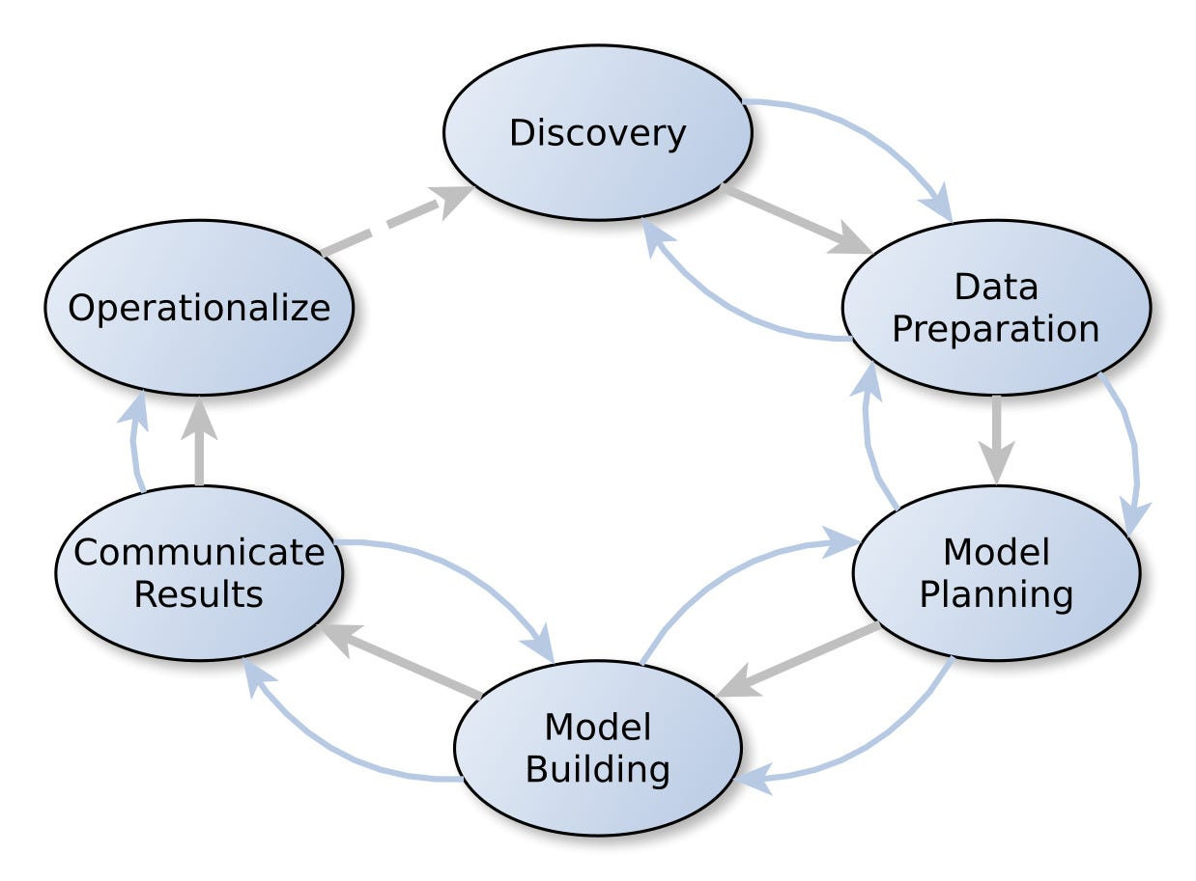
The data analytics process typically involves six key phases: Discovery, Data Preparation, Model Planning, Model Building, Communicating Results, and Operationalization. These phases are iterative and can sometimes overlap.

Slide 10
1. Discovery:
This initial phase focuses on understanding the problem you're trying to solve, defining objectives, and identifying relevant data sources.
It's crucial to understand the business context and stakeholder expectations to ensure the analysis is aligned with overall goals.

Slide 11
2. Data Preparation: This phase involves gathering, cleaning, and transforming raw data into a usable format for analysis.
This includes handling missing values, correcting errors, and ensuring data consistency.
3. Model Planning: In this phase, you choose the appropriate analytical techniques and develop a plan for how to use the data to solve the problem.
This may involve selecting statistical methods, machine learning algorithms, or other analytical tools.

Slide 12
4. Model Building:
Here, the chosen models are built and tested using the prepared data.
This involves creating training, testing, and production datasets and applying the selected analytical techniques.
5. Communicating Results: This phase focuses on effectively presenting the findings of the analysis to stakeholders.
This may involve creating visualizations, reports, and presentations to clearly communicate the insights and their implications.

Slide 13
6. Operationalization:
This final phase involves integrating the findings into the operational environment and making the insights actionable.
This may involve deploying the model, creating dashboards, or developing automated processes based on the analysis.

